Slide 1
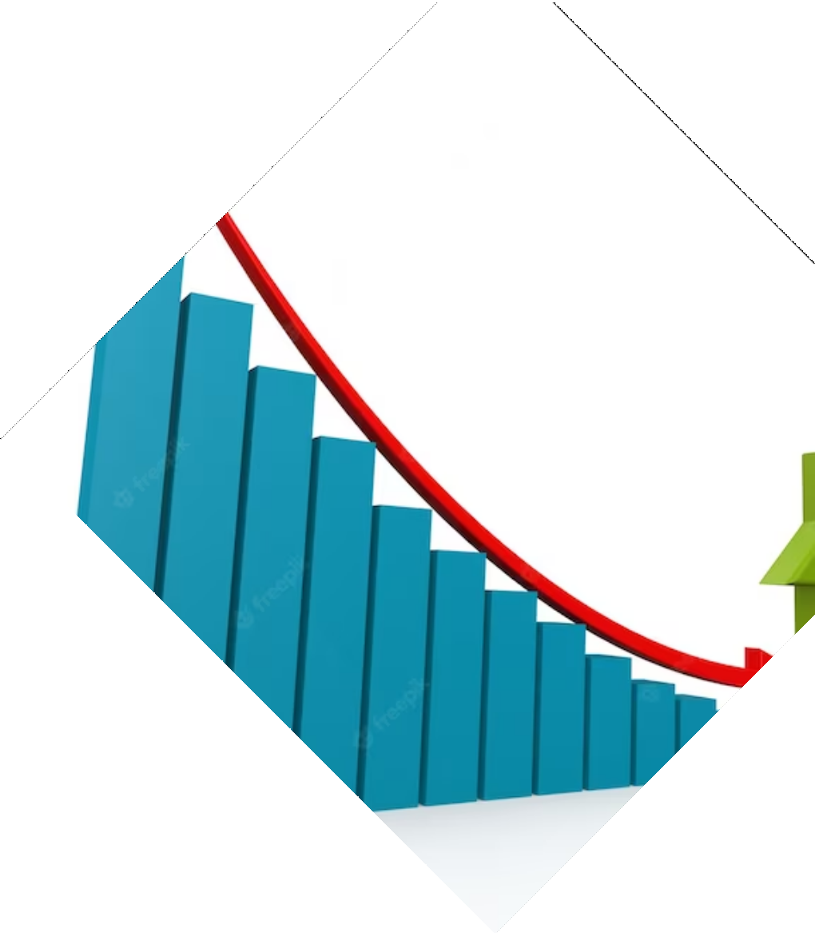
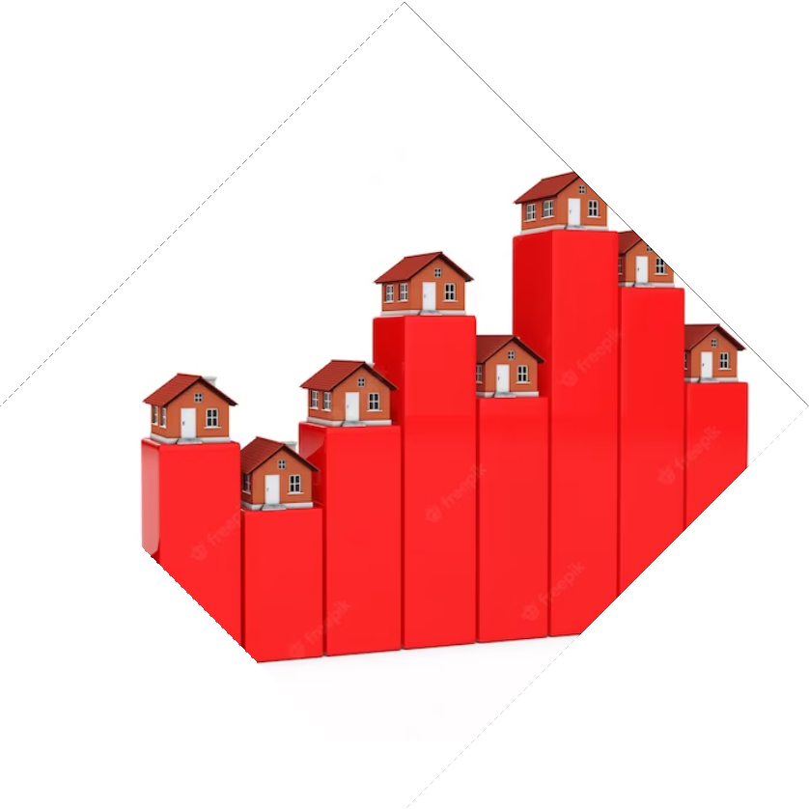
Crystal Balling the Future: Predicting Housing Prices.
Abdul Aziz Ramzan
160920748310

Slide 2

Introduction and Objective
Introduction: Welcome to the presentation on the Housing Price Prediction project.
Objective: The objective of this project is to predict housing prices based on various features and attributes of the houses.

Slide 3

Dataset & Data Exploration
The project utilizes a dataset that contains information about houses, including features such as area, number of rooms, location, etc.
The dataset is explored to understand its structure, feature distribution, missing values, and correlations between variables.
Visualizations: Visual representations of the dataset, such as histograms, scatter plots, and heatmaps, provide insights into the relationships between variables.

Slide 4


Data Preprocessing
The dataset is pre-processed by handling missing values, removing outliers, and transforming categorical variables into numerical representations.
Handling Missing Values: Techniques such as imputation or removal of missing values ensure the dataset is complete.
Outlier Detection: Outliers are identified and treated to prevent them from affecting the model's performance.
Categorical Variable Encoding: Encoding categorical variables into numerical representations allows the models to process the data.

Slide 5
Feature Engineering
Feature Engineering: New features are created based on domain knowledge and insights from the dataset to enhance the predictive power of the models.
Feature Transformation: Applying mathematical or statistical transformations to the existing features, such as log transformations or polynomial features, can improve model performance.
Feature Selection: Selecting the most relevant features based on their impact on the target variable helps simplify the model and improve interpretability.

Slide 6
Model Selection
Model Selection: Different regression models are considered, including linear regression, decision tree regression, and random forest regression.
Model Comparison: Evaluating the pros and cons of each model based on factors such as interpretability, complexity, and performance.
Model Selected :Random Forest Regression

Slide 7

Model Training
Model Training: The dataset is split into training and testing sets. The selected models are trained using the training data.
Training Process: The models are trained by fitting them to the training data and adjusting their internal parameters.
Cross-Validation: Employing cross-validation techniques, such as k-fold cross-validation, to ensure reliable model performance estimation.

Slide 8

Model Prediction
Model Evaluation: The trained models are evaluated using appropriate evaluation metrics such as mean squared error, root mean squared error, and R-squared.
Performance Metrics: Understanding the metrics used to assess the model's accuracy, precision, and generalization capabilities.
Interpretation of Results: Interpreting the model evaluation metrics to draw meaningful conclusions about the model's performance.

Slide 9
Conclusion
Conclusion: The project demonstrates the effectiveness of machine learning algorithms in predicting housing prices and highlights the importance of feature engineering and model selection.
Key Findings: Summarizing the key insights gained from the project and their potential applications in the real estate industry.

Slide 10
Thanks
Kaggle: Online community and platform for data science and machine learning.
GitHub: Web-based platform for version control and collaboration, commonly used for hosting code repositories.
Chat GPT: OpenAI's Chatbot model used for providing information and assistance in this presentation.

